Slide 1
Welcome to Linden Primary School

Slide 2
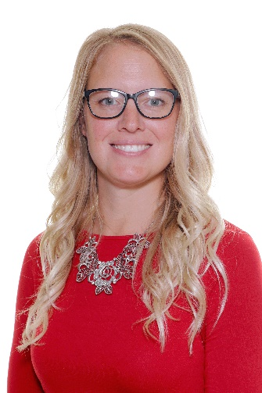
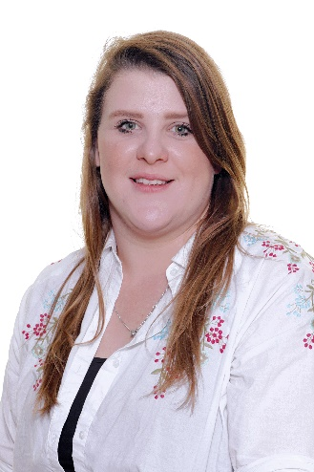
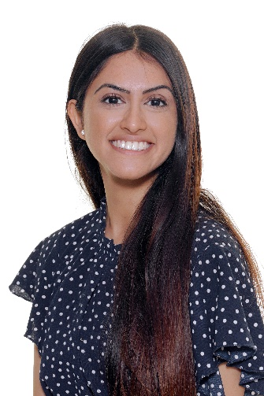
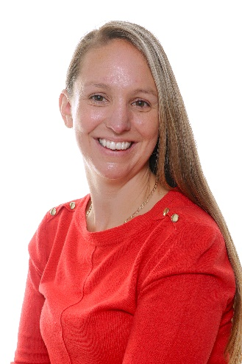
EYFS Staff
Mrs Pope
Mrs Phelps
Miss Gajjar
Mrs Loftus

Slide 3
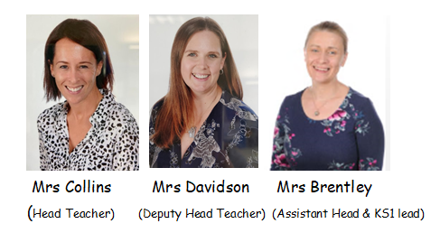
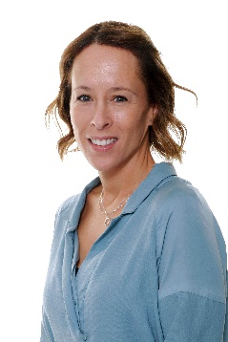
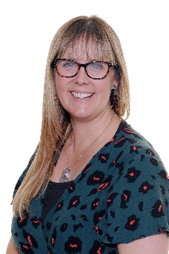
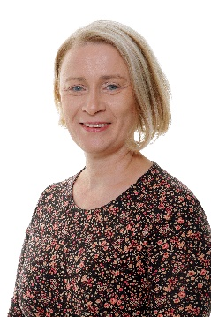
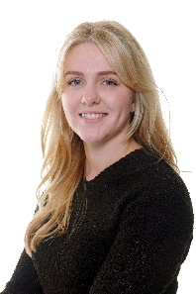
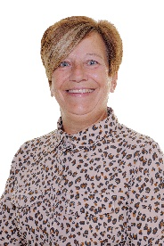
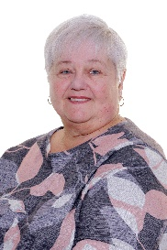
Key Members of Staff

Slide 4
Getting your child ready to start school in September
Transition into school: We have spoken to all preschool settings and have transition documents are being sent to us.
Drop in sessions; Monday 24th June, Tuesday 2nd July, Wednesday 17th July (all 2-2.30pm)
Promoting Independence: In the run-up to starting Reception, you need to make sure your child is capable of doing certain things for herself or himself such as;
Go to the toilet by themselves
Put on their uniform, shoes, socks, hat and coat. Providing clothing that makes this easy is important, for example shoes with Velcro fastening rather than laces, polo shirts rather than shirts with lots of buttons, and trousers which do not need a belt to stay up.
Tick sheet in pack

Slide 5
Bedtime: In the first couple of weeks before the start of school, make sure your child is in a good bedtime routine. Put them into bed at the same time every night and give them a wake-up call at the time they would need to get up to get ready for school.
Top tip: talk to your son or daughter about starting school. Explain that they will have lots of new exciting activities and will make new friends. Your excitement about it will be catching. If you're nervous, try not to let it show.

Slide 6
Staggered Entry
This is flexible and we will work with you to help decide when your child is ready to come to school full time. In most cases this will be on Monday 23rd September, however, we understand all children are individuals and we are happy to discuss any matters as and when they arise.

Slide 7
Trust the staff. We have your child’s best interest at heart.
We have welcomed many children into EYFS and through this transition many times.
We ensure transition to school is smooth.
We want to know all about your child- No detail too small – parent consultation meetings are perfect for these details prior to your child joining our school.
Staff always on the door in the morning.

Slide 8
School Timetable
Morning
Pupils can enter school from 8.45am
9.00am is the start of the school day and registration
9.05 Dough Disco
9.15-10.00 English/Maths
10.00-10.40 Snack
10.50-12.00 English/Maths
Lunch
Reception have lunch 11.45—12.45pm
End of day 3.05pm (EYFS class doors will open at 3.05pm to allow pick up from 3.05pm-3.10pm)
Drop-off and collection
Drop off for class 1 will be through the black gate on the Reception Playground and Class 2 through the first blue door as you walk through the school gates (staff will be there to help guide you)
Getting to School
To get to and from school, walking is definitely the best option! You can cycle but please be careful!! If you do need to travel by car, please park wisely.

Slide 9
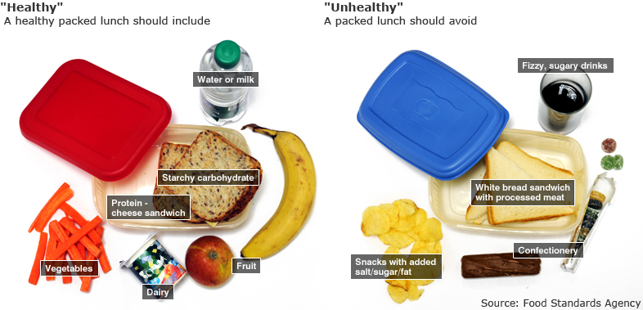
Lunches, Milk and Fruit
Lunchboxes
Lunchboxes must be labelled and placed in the Lunchbox trolley. Please ensure that your child has a balanced, healthy lunch.
Fruit
All children will be given free fruit
during fruit and milk time.
Universal Free School Meals
All Reception children are entitled to a free school meal.
Please fill out forms.
Cool Milk
This website can be used to sign your child up for milk or can be used to find out if you are eligible for free milk.
https://www.coolmilk.com/

Slide 10
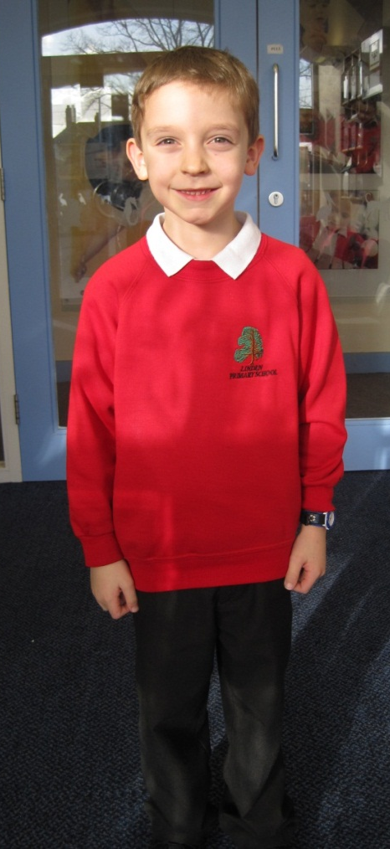
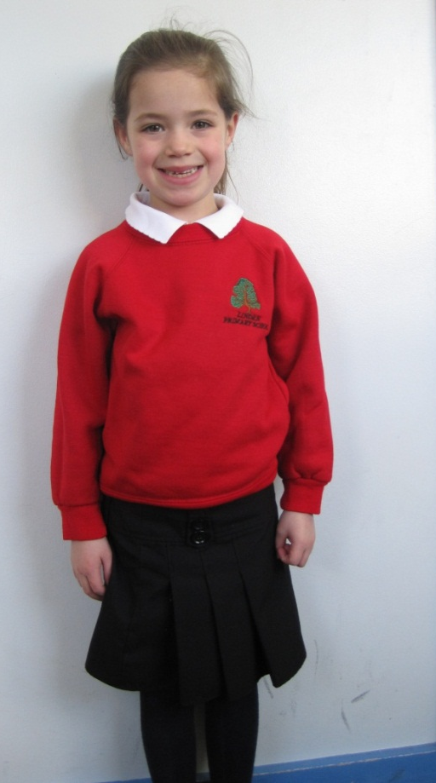
Uniform
Please make sure all clothing and book bags are labelled with both names.
The school is not responsible for unnamed clothes/items that go missing.
Children should wear sensible shoes that they can run and play in.

Slide 11
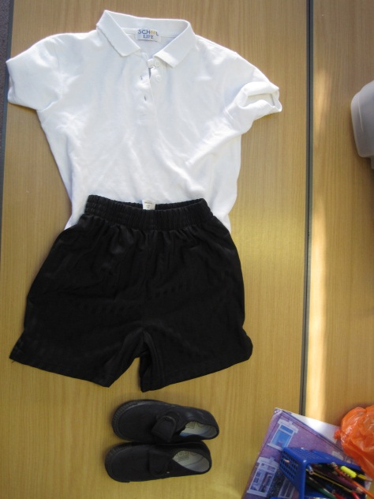
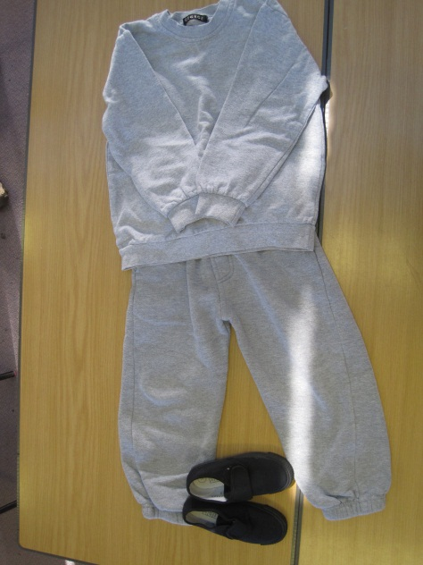
P.E
Please bring their PE kit on the
first day of school. P.E kits will be
kept in their labelled bag on your
child’s peg.
PE timetable to be
communicated with parents in
September.
Studs to be taken out for P.E or
covered with masking tape.

Slide 12
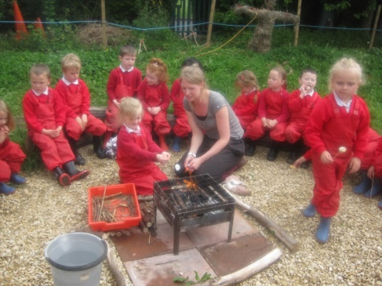
Forest School
Your child will be visiting Forest School every week. It is situated at the back of the School field.
Children will need to bring in a set of their own wellington boots and waterproofs, waterproofs will be kept on their peg in a bag and wellington boots in our wellie tub.
Please ensure both are clearly labelled.

Slide 13
Evidence Me
Emails will be sent in September from 2Simple
Click link to activate your account
Receive updates on what we are doing in school
Send in observations from home; homework or experiences
'How to' guides are available if needed

Slide 14
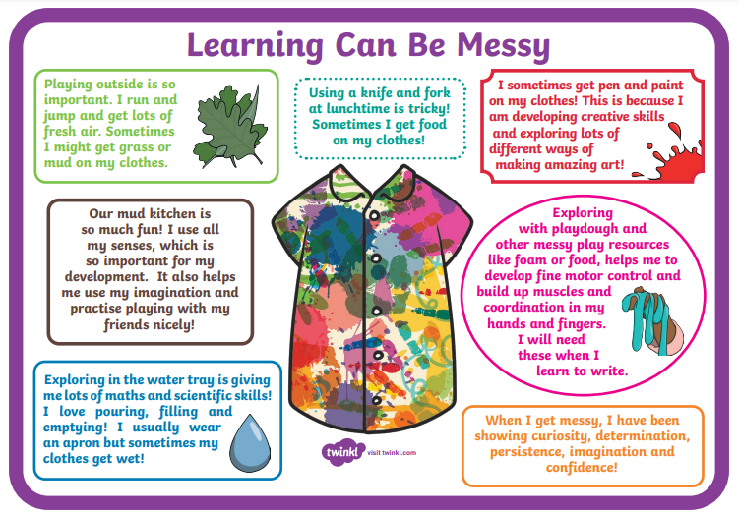

Slide 15
Emotion Coaching
Would you like support to help your child become more aware of their emotions and manage their behaviour?
You may be interested in our:
Emotion Coaching Parent Workshops
Parents can sign up for a series of 4 sessions where you will receive practical advice in a supportive environment with a small group of parents. We will provide practical resources, tea/coffee and cake/biscuits!
What? 4 sessions on a weekly basis
When? Each series will run during a half term
How long? 1 ½ hours per session

Slide 16
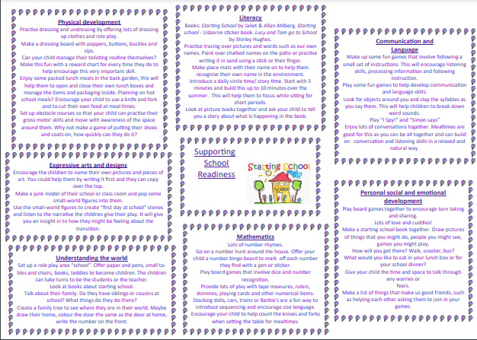
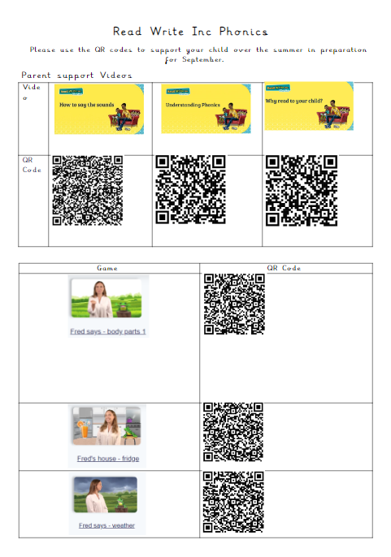
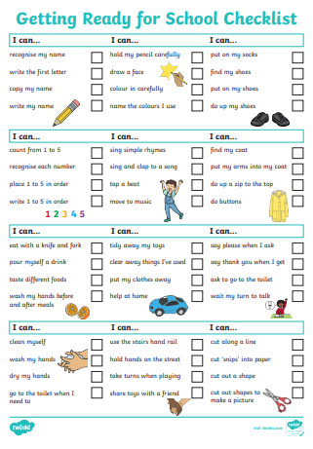
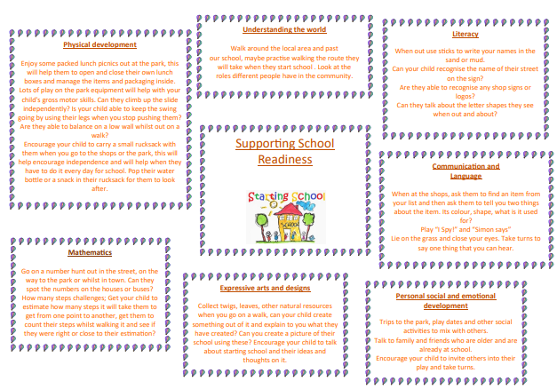
Packs sent home to you

Slide 17
What next….
Tour of Reception
Any Questions
Birth certificates – collect
Reminder drop in sessions - Monday 24th June, Tuesday 2nd July, Wednesday 17th July (all 2-2.30pm)
Parent consultation meetings W/C 8th July – check your times with a member of staff if unsure
If you haven’t done so already, please send in all forms as soon as possible

